Slide 1
Machine Learning with SQL Server
Part 3 – Create a model
Damian Widera

Slide 2

Agenda
Modelling
By Kenneth Jensen - own work based on: ftp://public.dhe.ibm.com/software/analytics/spss/documentation/modeler/18.0/en/ModelerCRISPDM.pdf (Figure 1), CC BY-SA 3.0, https://commons.wikimedia.org/w/index.php?curid=24930610

Slide 3
Modelling

Slide 4
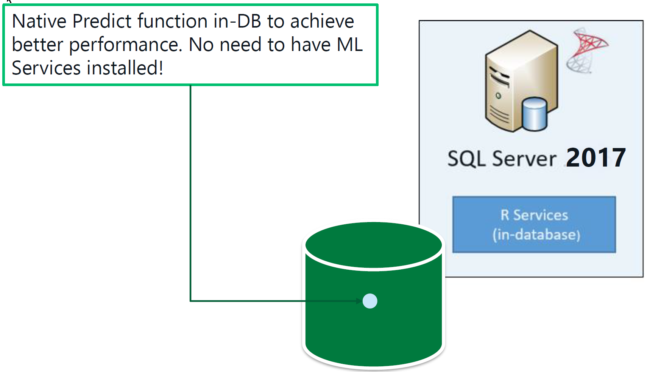
Native Scoring using PREDICT function
Requirements:
rx* models only
Serialized model from rxSerializeModel (R)
Serialized model from rx_serialize_model (Python)
Key Benefits:
Runs natively in SQL Server (No R / Python dependency)
Low latency for execution
Ideal for highly concurrent scoring of few rows
Can be used in INSERT/UPDATE/MERGE statement directly

